Slide 1
Design for Artificial Intelligence

Slide 2
But First!! Lets talk about Data and AI

Slide 3
What is Data ?
How is it Generated ?
Notes:
Data – a collection of facts (numbers, words, measurements, observations, etc) that has been translated into a form that computers can process. Resource: https://www.import.io/post/what-is-data-and-why-is-it-important/
Computers represent data, including video, images, sounds and text, as binary values using patterns of just two numbers: 1 and 0. A bit is the smallest unit of data, and represents just a single value. A byte is eight binary digits long. Storage and memory is measured in megabytes and gigabytes. Resrouce: https://searchdatamanagement.techtarget.com/definition/data

Slide 4
Around 2.5 quintillion bytes of Data is generated everyday.

Slide 5
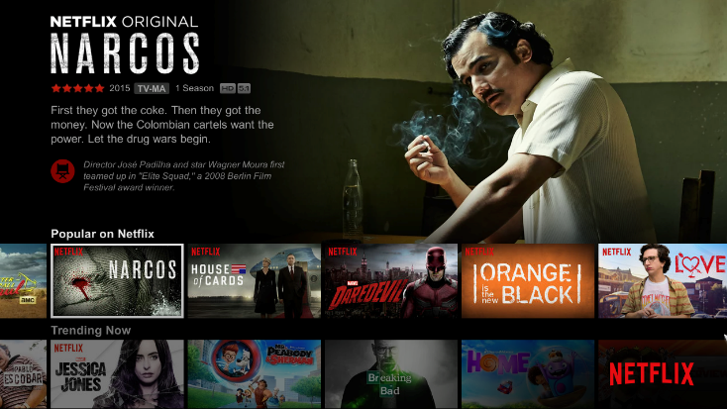
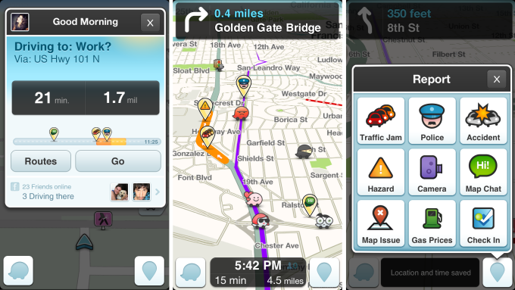
Data is Everywhere Influencing What We Do
Netflix provides personalized recommendations
Waze provides a personalized driving experience
Uber delivers food that you like and is the right temperature
Self driving cars react to changing conditions
ALL based on DATA
Notes:
The point I want to make here really is that no matter which industry you are in – whether it be travel and transportation, food, delivery, service, or IT and high-tech – or you are in the business of managing and selling content like movies, AI is what ALL successful organizations are using.
Artificial intelligence (AI) is no longer the future. For businesses, it is the here and now,
Whether it is Netflix who is using all of the data they have on movies, clients, etc. to provide personalizes recommendations for everybody, even with multiple people on an account. Or it is Waze who is able to understand traffic speeds, accidents, tolls, the speed limits and what other people are reporting along the road to determine the best route to get to where you want to go – based on any set criteria. Or Uber eats who use an algorithm to understand when to place an order with a restaurant so that it’s picked up and delivered at the right temperature making everybody happy. Or self driving cars that look at everything that surrounds the car and changing conditions.
Some of these are very successful - nobody can argue with Netflix or Waze or Uber. But some are not quite a successful, just got ask Google and their self driving car.
But everything, here all of these solutions and applications, are based on the data - Or ultimately the intelligence or AI that is applied to that data to make the right decisions and recommendations.

Slide 6
The importance of Data
Data driven HR.
Companies target
Data driven Strategies
Relate to Customers

Slide 7
What is it all about?
Artificial Intelligence
Machine Learning
Machine
Learning
Traditional
Research
Data Science
Data
Science
Deep Learning
Danger
Zone

Slide 8


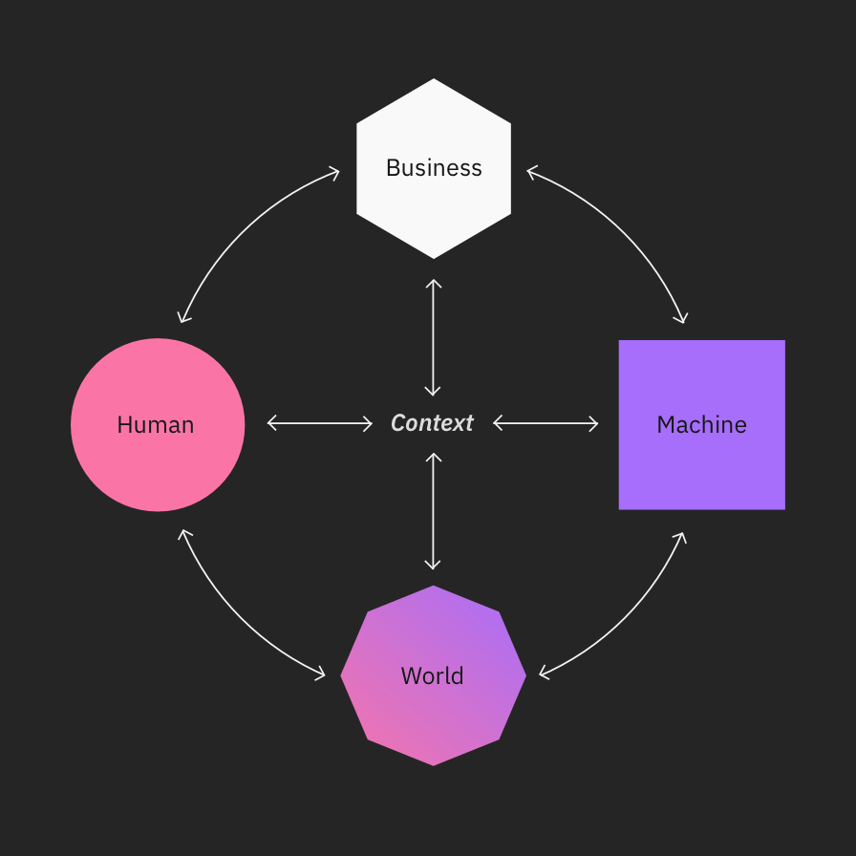



AI ecosystem

Slide 9
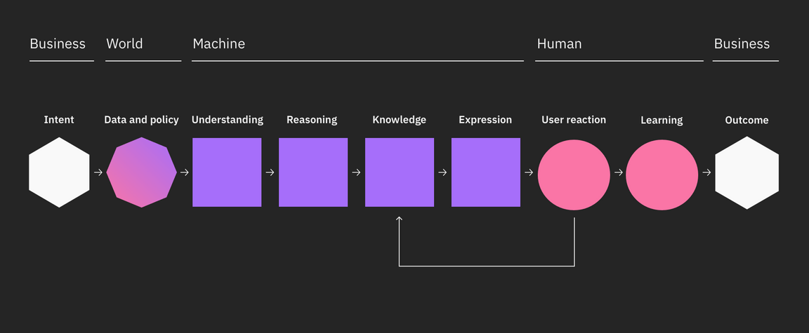
AI / human context model

Slide 10
Intent: The goals, wants, needs, and values of users and businesses. Intent provides your solution’s purpose.
Data and policy: All of the significant raw data a machine can collect from the user and the world and the policies that protect it.
Understanding: The process of putting incoming structured and unstructured data in context of your domain. Also known as machine learning.
Reasoning: The system’s application of logic to decide on the best course(s) of action.
Knowledge: This is what the system knows. This is all past data, insights, and learned attributes measured up against the overall intent of the system.
Expression: How the system delivers its response based on the content of the message and its understanding of the user.
User reaction: This is the user’s genuine reaction to the system’s expression. Based on the quality of the system’s response.
Learning: The user is continually teaching the system to improve through direct and indirect responses.
Outcome: The consequences of an actualized system used in the real world to solve real users’ real problems.

Slide 11
How does AI work
Rules-based
The rules-based approach uses algorithms — a sequence of unambiguous instructions used by computers to solve problems. It tells a computer precisely what steps to take to solve a problem or reach a goal.
Examples based
The examples-based approach uses data to create models. This data can take many forms: music, videos, weather conditions, user profiles, system logs, etc. Models are the result of training an AI on data to find patterns.

Slide 12
Everyday Ethics for AI
Everyday ethics for AI provides discussion points concerning:
specific virtues that AI systems should possess;
guidance for designers and developers training and building AI.
Five Ethical Focal Areas
Accountability
Value Alignment
Explainability
Fairness
User Data Rights

Slide 13
Accountability
AI designers and developers are responsible for considering AI design, development, decision processes, and outcomes.
Human judgment plays a role throughout a seemingly objective system of logical decisions. It is humans who write algorithms, who define success or failure, who make decisions about the uses of systems and who may be affected by a system’s outcomes.
Every person involved in the creation of AI at any step is accountable for considering the system’s impact in the world, as are the companies invested in its development.

Slide 14
Value alignment
AI should be designed to align with the norms and values of your user group in mind.
AI works alongside diverse, human interests. People make decisions based on any number of contextual factors, including their experiences, memories, upbringing, and cultural norms.
Today’s AI systems do not have these types of experiences to draw upon, so it is the job of designers and developers to collaborate with each other in order to ensure consideration of existing values. Care is required to ensure sensitivity to a wide range of cultural norms and values.

Slide 15
Why is Value Alignment Imperative? Market Research Predictions
“AI technology is vulnerable to implicit and explicit bias, logic gaps and general algorithm complexities. At scale, these biases can affect entire groups of people and, depending on the AI’s purpose, the impact can be severe.” – Gartner: Gartner Top Strategic Predictions for 2020 and Beyond, October 22, 2019
“Through 2022, 85% of AI projects will deliver erroneous outcomes due to bias in data, algorithms and AI team composition.” – Gartner: Maverick* Research: Artificial Intelligence Requires Immediate Global Governance and Regulation, June 13, 2019
“In the face of daily incidents, many consumers, citizens, and partners have lost faith in technology, business, and government, creating a crisis of trust.” – IDC: IDC FutureScape: Worldwide Artificial Intelligence 2020 Predictions, October 31, 2019

Slide 16
Explainability
AI should be designed for humans to easily perceive, detect, and understand its decision process.
In general, we don’t blindly trust those who can’t explain their reasoning. The same goes for AI, perhaps even more so.
Your users should always be aware that they are interacting with an AI. Good design does not sacrifice transparency in creating a seamless experience. Imperceptible AI is not ethical AI.

Slide 17
Why is Explainability Imperative? Case Study: International Baccalaureate Organization
In a normal year, final grades are determined by coursework produced by the students and a final examination administered and corrected by the IBO directly.
The coursework counts for 20-30% of the overall final grade and the exam accounts for the remainder. Prior to the exam, teachers provide “predicted” grades, which allow universities to offer places conditional on the candidates’ final grades meeting the predictions. The IBO will also arrange independent grading of samples of each student’s coursework in order to discourage grade inflation by schools.
Problem: Covid-19 prevented 2020 graduating students from sitting for final IB exams.
Solution: IBO turned to AI. Using its trove of historical data about students’ course work and predicted grades, as well as the data about the actual grade obtained at exams in previous years, the IBO decided to build a model to calculate an overall score for each student – in a sense predicting what the 2020 students would have gotten at the exams.
Outcome: Tens of thousands of students all over the world received grades that not only deviated substantially from their predicted grades but did so in unexplainable ways. Lack of transparency and explainability.
Lesson Learned: The main lesson coming out of this experience is that any organization that decides to use an AI to produce an outcome as critical and sensitive as a high-school grade marking 12-years of student’s work, needs to be very clear about how the outcomes are produced and how they can be appealed in the event that they appear anomalous or unexpected.
Source: https://hbr.org/2020/08/what-happens-when-ai-is-used-to-set-grades

Slide 18
Fairness
AI must be designed to minimize bias and promote inclusive representation.
AI provides deeper insight into our personal lives when interacting with our sensitive data. As humans are inherently vulnerable to biases, and are responsible for building AI, there are chances for human bias to be embedded in the systems we create.
It is the role of a responsible team to minimize algorithmic bias through ongoing research and data collection which is representative of a diverse population.

Slide 19
User data rights
AI must be designed to protect user data and preserve the user’s power over access and uses.
Pew Research recently found that being in control of our own information is “very important” to 74% of Americans.
The European Commission found that 71% of EU citizens find it unacceptable for companies to share information about them without their permission.

Slide 20
Ways to excel in Data Science
Build foundations – Cognitiveclass.ai | Coursera | IBM Developer Site
Tools – Opensource, company specific etc.
Internship – Companies, Telcom, Banks, Startups working with AI.
Competitions – Local events, Webinars , Hackathons.
Kaggle – Participate in competitions, maintain Kaggle profile.

Slide 21
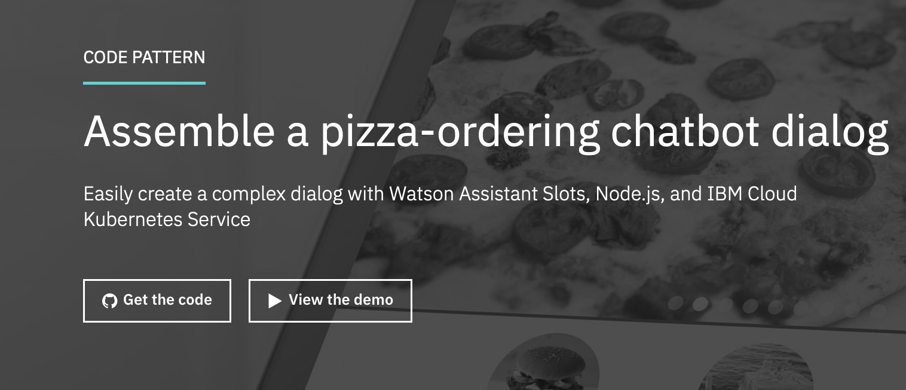
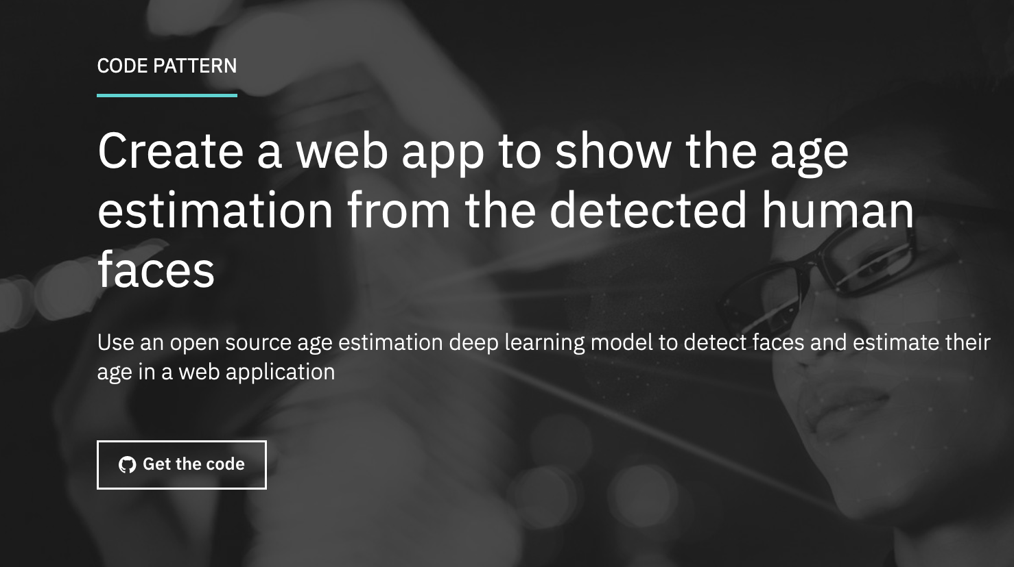
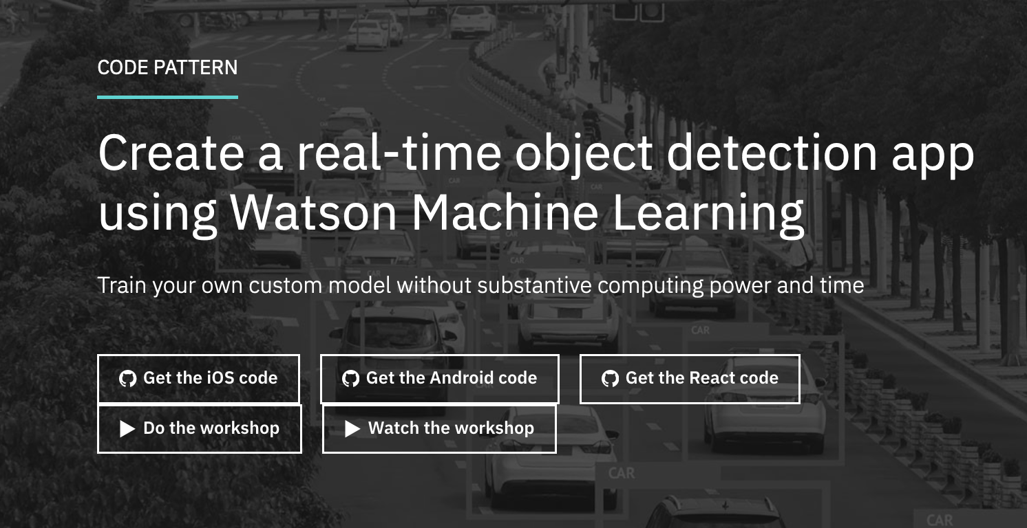

Data Science Use-Cases

Slide 22
Explore IBM Developer site - https://developer.ibm.com
Assemble a pizza-ordering chatbot dialog –
https://developer.ibm.com/patterns/assemble-a-pizza-ordering-chatbot-dialog/
Build your chatbot with Watson Conversation and entities from Watson NLU –
https://developer.ibm.com/blogs/build-your-chatbot-with-watson-conversation-and-entities-from-watson-nlu/
Create a real-time object detection app using Watson Machine Learning –
https://developer.ibm.com/patterns/create-a-real-time-object-detection-app-using-watson-machine-learning/

Slide 23



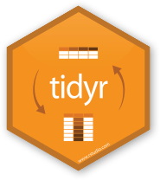















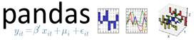
Data Science Tools – Libraries and Frameworks

Slide 24
Thank you

